Slide 1
Shoreline Hazards and Habitat Loss- MD
Natalia Solomon

Slide 2
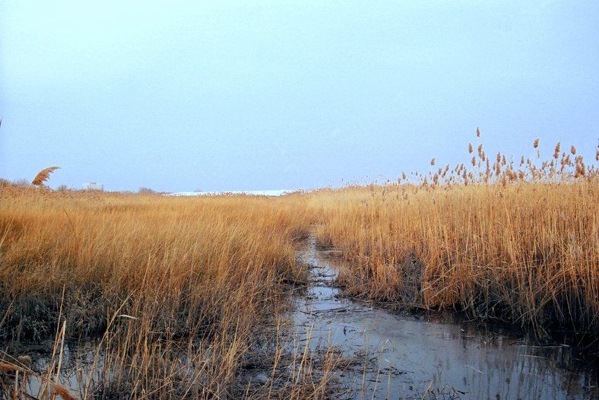
Background Information
What does the future look like when our natural coastal protection systems begin to weaken?
Coastal habitats include marshes, oyster reefs, dunes, forests, and underwater grass
Where land meets water, coastal habitats support ecosystems and nearby communities
Coastal habitats are constantly changing
Coastal hazards include geomorphology, elevation, erosion, sea level rising, waves, and storm surges

Slide 3

Goals and Tools
We have seen through real world examples about how coastal habitats can protect communities, but what areas need the most protection? Do certain habitats provide protection to certain areas? How does the future of these habitats look? My goal is to tell a story about the benefits and risks of our coastal habitats in Maryland.
To answer my questions, I will be visualizing my data using Google Colab. With the help of other tools such as R studio and Tableau, I am able to get a good idea of how my data looks before refining visualizations for presenting.

Slide 4
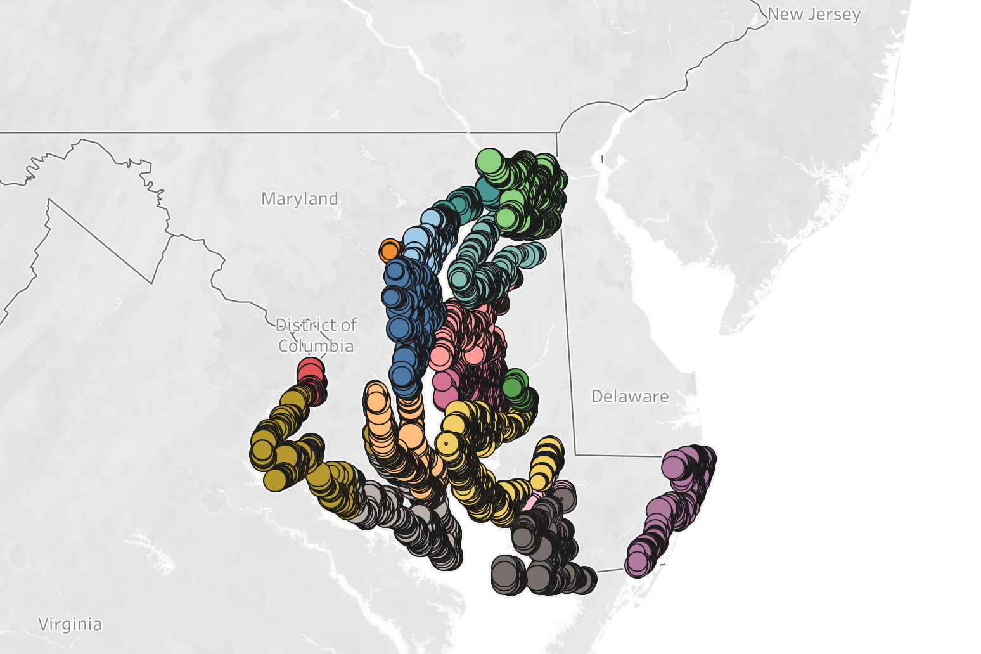
Datasets
My data comes from the Maryland Coastal Resiliency Assessment
and was created by the Maryland Department of Natural Resources and The Nature Conservancy to identify priority restoration and protection areas for communities at risk from coastal hazards
Main dataset: Shoreline Hazard Index
Includes coastal habitat and hazard data
Contains six physical hazard variables and five habitat types
Also includes location-based descriptive data
Second dataset: Marsh Protection Potential Index
Used with main dataset for deeper analysis
Focuses on habitat conditions, resilience, and community risk

Slide 5

Cleaning
I cleaned my dataset by first inspecting its structure and merging two datasets using a shared ID. I then converted categorical variables into numerical values to make them easier to analyze and ensured hazard variables were treated as ordered categories. After addressing missing data, I finalized a clean dataset with fewer rows but no missing values.
My final dataset had 11,280 rows and I ended up using 24 of the 47 columns

Slide 6
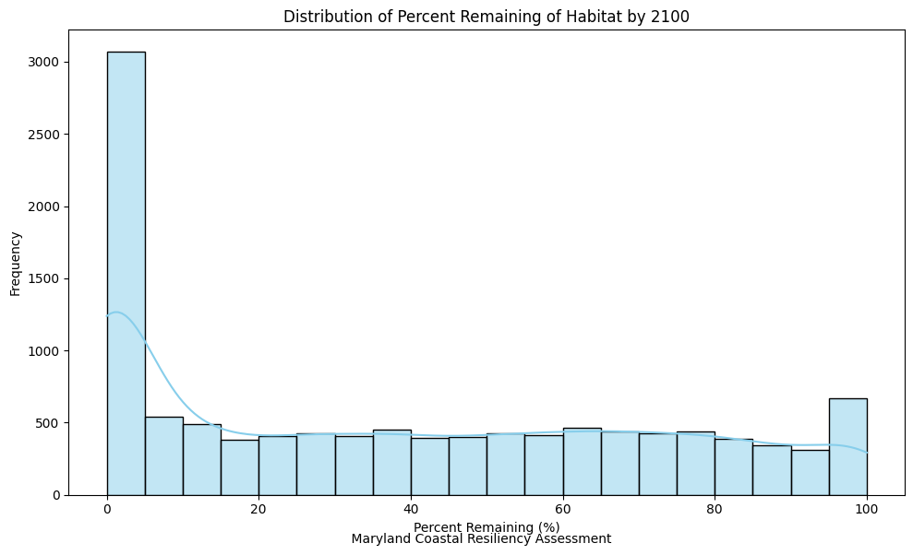
Visualizations
visualized what the future of coastal habitats might look like using the variable PercentRemaining2100
distribution is strongly right-skewed
many areas are expected to retain only a small percentage of their habitats by 2100
peak on the left side indicates a large number of locations with very low habitat remaining
tail of the distribution shows that some areas are more resilient than others
important to investigate what factors contribute to both habitat loss and long-term resilience

Slide 7
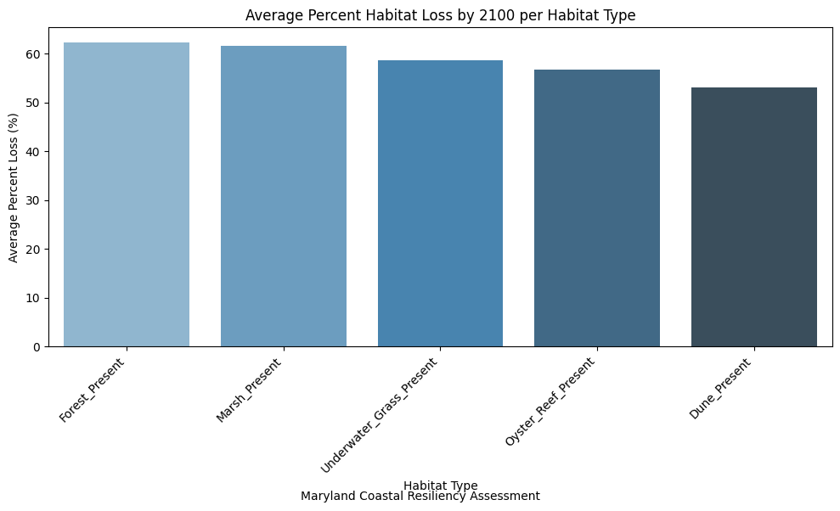
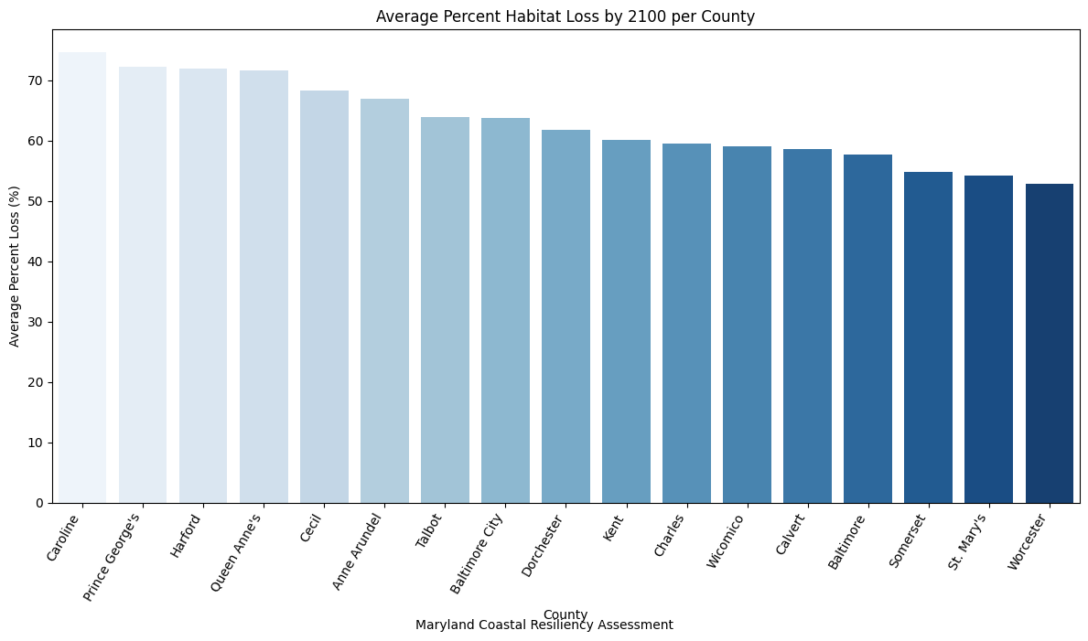
examined how habitat loss varies across different habitat types to understand which ecosystems are most affected
forests and marshes are expected to lose over 60% of their area on average, while underwater grass, oyster reefs, and dunes are projected to lose less than 60%
small differences still important when considering targeted conservation strategies
compared habitat loss across counties to identify which areas are most at risk
variation across regions
Caroline County experiencing the highest average loss (74.7%), while Worcester County has a lower average loss (52.8%)

Slide 8
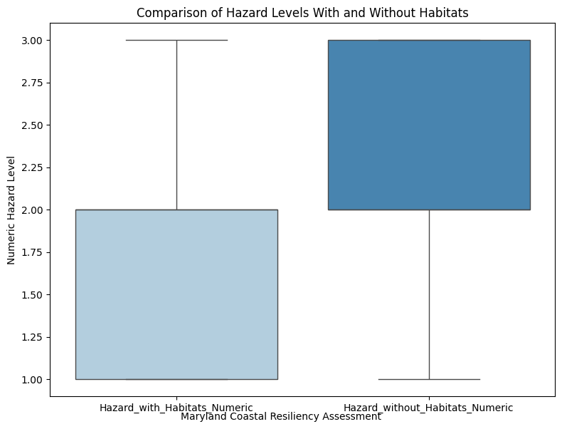
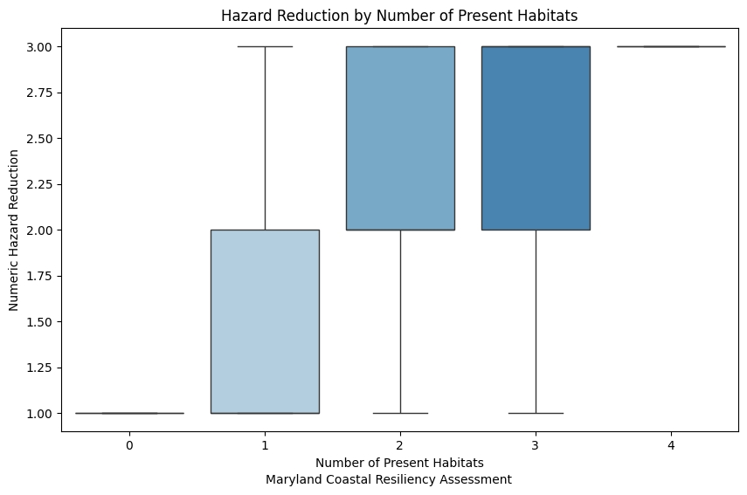
compared hazard levels with and without the presence of habitats
areas with habitats tend to experience lower average hazard levels than areas without them
hazards are measured on a scale from 0 to 4 and include geomorphology, elevation, sea level rise, waves, storm surge, and erosion
areas with more habitat diversity tend to have lower hazard risk
locations with two or three habitat types show stronger protection compared to areas with only one type
protection may weaken in the future as habitats continue to decline, reducing overall resilience

Slide 9
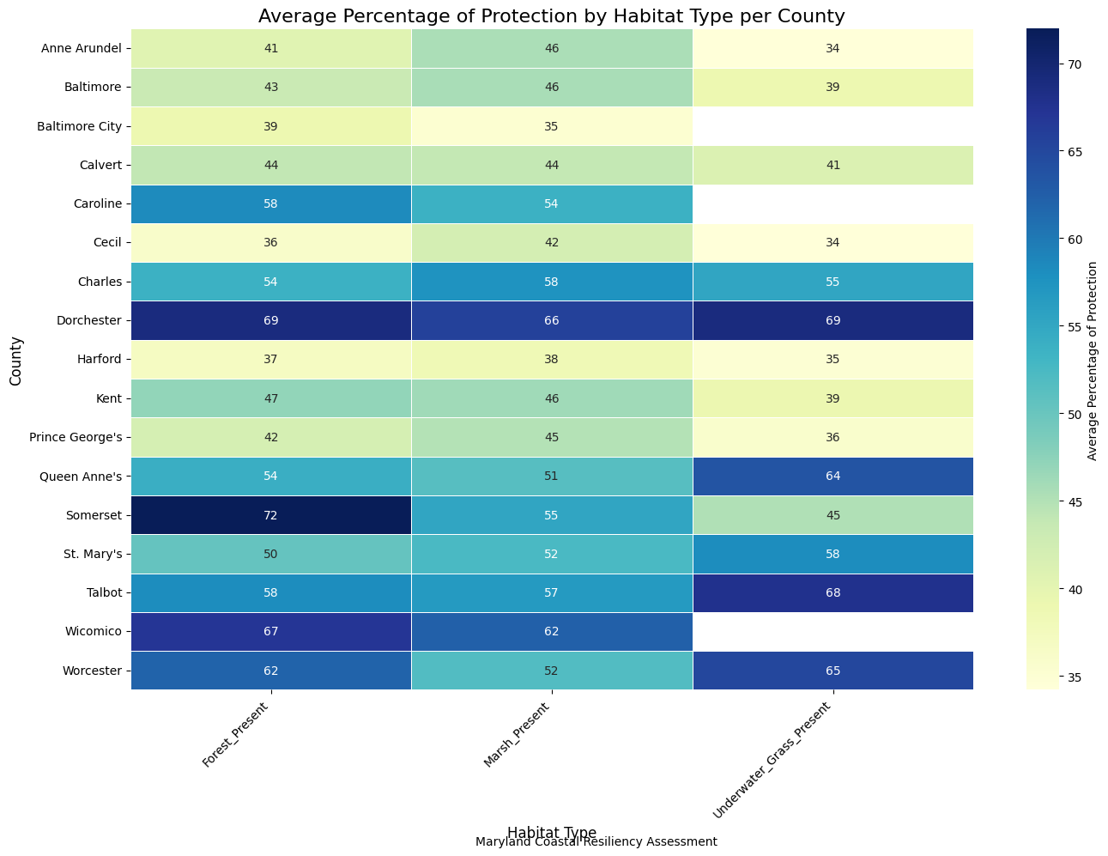
visualized the average protection provided by different habitat types across each county
Caroline County is among the areas with the highest projected habitat loss
Caroline County’s coastal protection mainly comes from marshes and forests
suggests that Caroline County (and similar areas) could be key priorities for targeted habitat protection efforts
Removed dunes and oyster reefs due to missing data

Slide 10
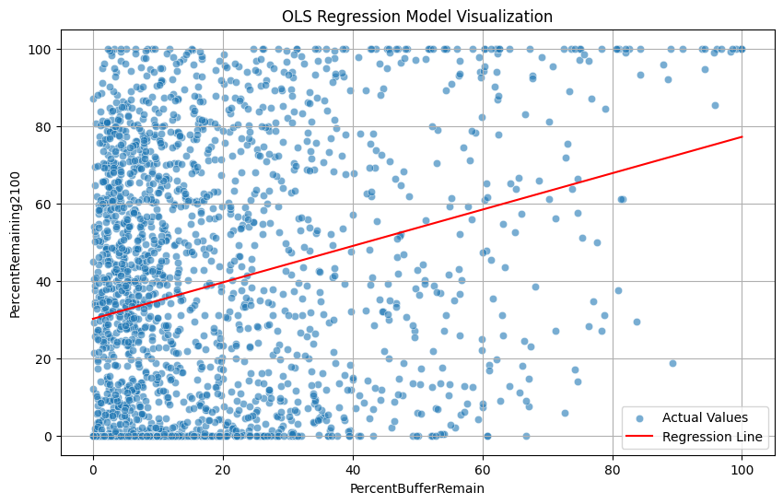
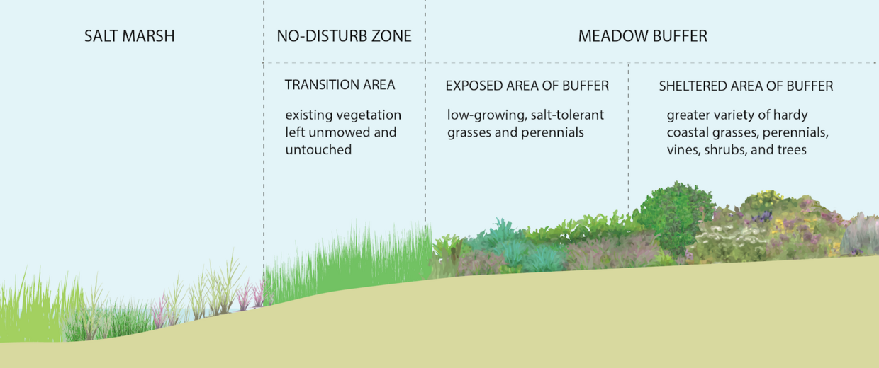

Regression Model
built a regression model to examine the relationship between habitat buffer preservation and long-term habitat outcomes
prepared the data by selecting PercentRemaining2100 as the target variable and PercentBufferRemain (not being occupied by humans) as the predictor, then splitting the data into training (80%) and testing (20%) sets
scaled the predictor and fit an OLS linear regression model to analyze the relationship
evaluated using R² and RMSE, and visualized with a scatterplot and regression line
weak but statistically significant relationship between buffer preservation and habitat remaining in 2100

Slide 11
Key Findings
Coastal habitats play a key role in reducing hazard risk, with areas that have more or diverse habitats generally experiencing lower exposure to hazards.
Habitat loss is not uniform where some ecosystems and some counties are more affected than others, highlighting uneven vulnerability.
Habitat diversity seems to strengthen natural protection, but this protection is at risk as habitats continue to decline.
Buffer preservation shows a positive but weak relationship with long term habitat survival, suggesting it contributes to resilience
protecting and restoring coastal habitats and their surrounding buffers is important

Slide 12
Reflection and Next Steps
What was especially challenging in this project was trying to create a story. At first, I had a bunch of graphs that I did not know how to connect or how I could apply it to the real world.
This project could be expanded by exploring how communities would be impacted if a natural hazard were to show up. The social vulnerability index describes how much help a community would need after flooding. Comparing this with community flood risks, we can see if communities that would need more help actually are at higher risks.
What was rewarding in the end after facing obstacles was finding information I did not think I would find. I would have never guessed that so much habitat loss would occur in less than 100 years.
This started coming together when I began exploring variables that I thought would be too challenging to use. However, these variables were key to uncovering information. In the future, I will not overlook variables just because I don’t understand them.

Slide 13
Acknowledgements
I would like to thank some people that supported my understanding of the tools and concepts that I used in this project. This includes:
Professor Alraee
Professor Perine
Professor Park
Early College Data Science Cohort
Data 205 Classmates

Slide 14
Thank You!

